Slide 1

ACS Architecture
Solr Overview
Repository Concepts

Slide 2
Table of Contents
ACS Architecture overview
Alfresco Platform Overview
Alfresco Application Server
Alfresco Repository Overview
Content Services
APIs
Protocols
Subsystems
Solr Overview
Users, Groups, Roles and Permissions
Repository Physical and logical overview

Slide 3
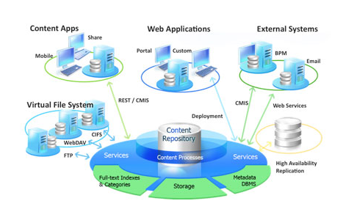
Alfresco Architecture
At high level Alfresco is a client-server based architecture. Server provides content management services and client provides user interfaces to solution.
3

Slide 4
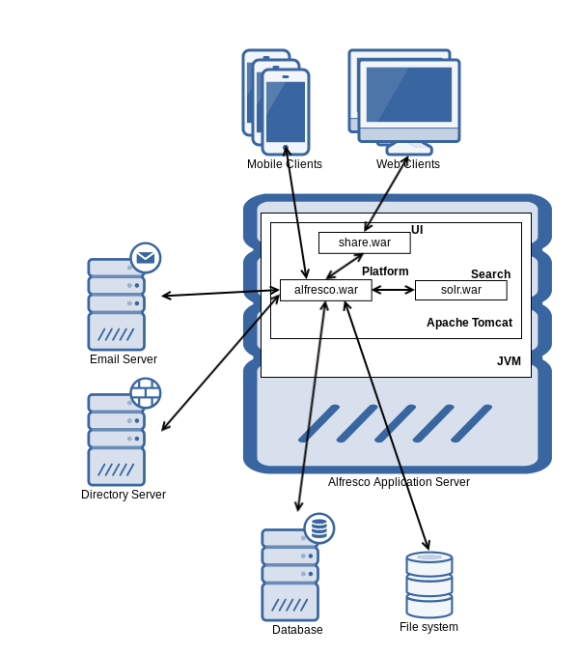
ACS Platform Architecture
At high level Alfresco content services is a client-server based architecture. Server provides content management services and client provides user interfaces to solution.

Slide 5
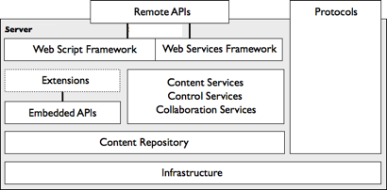
ACS – Application Server
At the heart of Alfresco Content Services is the application server, which manages and maintains the repository.
Application server exposes a set of remote public interfaces for allowing a client to communicate with it.
Remote APIs - for interacting with services of the server programmatically
Protocol bindings - for mapping services for use by a protocol-compliant client

Slide 6
ACS – Repository Capabilities
The repository is comparable to a database, except that it holds more than data.
The binary streams of content are stored in the repository and the associated full-text indexes are maintained by SOLR indexes.
Outlook Client
Mobile App
Cloud Sync
Alfresco Share
Records Management
Media Management
Reports and Analytics
Alfresco Repository
Transformations
Rules / Policies
Protocols
Database
Activiti Workflow Engine
Authentication
Web Scripts
FS Content Store
APIs (CMIS)
Auditing
Scheduled Jobs
Alfresco SOLR
Indexes

Slide 7
Content Services
Services address the core use cases for content management applications including the logical organization of content, file management, version control, and security.
Services also support the control of content through workflow and process management, and social and collaborative applications.
Alfresco Content Services exposes services at various levels including:
Java
Scripting
REST
Web services
Client interfaces, such as Alfresco Share
Alfresco services are divided into two main categories:
Content Repository services
Content Application services

Slide 8
Content Repository services
Content repository services are the fundamental services for working with content in Alfresco. Content repository services are written in Java.
Content repository services are built on the storage and query engines. The concept of users and groups is introduced into these services
Content repository services provide capabilities like:
Organize and manage content
Control versions
Record changes and updates
Enforce security
Model content types
Search for information in the repository
Few OOTB Content Repository services are:
File Folders service, Versioning service, Check-in/Checkout service, Audit service
Permission service, Person service, Dictionary service, Search service

Slide 9
Content Application services
Content application services extend the repository services, providing extended capabilities for rich content and collaborative applications.
Content application services are divided into three main categories:
Content—provide advanced content management capabilities
Control— encapsulate processes through which content flows.
Collaboration— integrates the production and publishing of content into social networks.

Slide 10
APIs
To access and extend out-of-the-box services, the content application server exposes two flavors of API, each designed for a specific type of client.
There are two main categories of API:
Embedded APIs - used for developing extensions to the application server.
Remote API - used to build ECM solutions against the content application server.

Slide 11
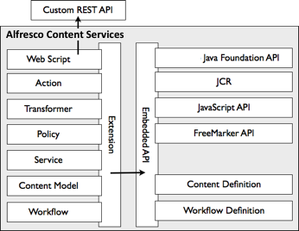
Embeded APIs
Embedded API comes in several forms, where each form is structured for a particular need or kind of extension:
Alfresco Public Java API - a set of public Java interfaces exposed by services built into the content application server
JavaScript API - an object-oriented view of the Java Foundation API specifically tailored for use in JavaScript.
FreeMarker API - an object-oriented view of the Java Foundation API specifically tailored for use in FreeMarker templates
Content Definition - an API for creating and editing content models
Workflow Definition - an API for defining business processes

Slide 12
Remote APIs
There are three main remote APIs:
Alfresco Content Services API
CMIS API
Repository REST API (Deprecated)
ACS API is main remote API, and is the recommended API for developing remote client applications to work across cloud, on-premise and hybrid deployments.
CMIS provides a standardized set of common services for working with content repositories.
Alfresco Content Services provides an implementation of CMIS Web service and RESTful bindings, as well as a CMIS client API for use in Surf and other environments.
Repository REST API provides access to the core repository functionality using a RESTful approach.

Slide 13
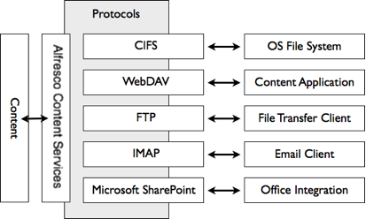
Protocols
The content application server supports many folder and document-based protocols to access and manage content held within the repository using familiar client tools.
Most protocols permit updates, allowing a client tool to modify the folder structure, create and update documents, and write content.
Some protocols also allow interaction with capabilities such as version histories, search, and tasks.
Notes:
CIFS (Common Internet File System):
CIFS allows the projection of Alfresco Content Services as a native shared file drive. Any client that can read and write to file drives can read and write to Alfresco Content Services, allowing the commonly used shared file drive to be replaced with an ECM system without users even knowing.
WebDAV (Web-based Distributed Authoring and Versioning)
WebDAV provides a set of extensions to HTTP for managing files collaboratively on web servers. It has strong support for authoring scenarios such as locking, metadata, and versioning.
FTP (File Transfer Protocol)
FTP is a standard network protocol for exchanging and manipulating files over a network. This protocol is particularly useful for bulk loading folders and files into the repository.
IMAP (Internet Message Access Protocol)
IMAP is a prevalent standard for allowing email access on a remote mail server. Alfresco presents itself as a mail server, allowing clients such as Microsoft Outlook, AppleMail, and Thunderbird to connect to and interact with folders and files held within the repository.
Microsoft SharePoint Protocols
Alfresco Office Services support Microsoft SharePoint Protocols. This allows Alfresco Content Services to act as a SharePoint server, creating tight integration with the Microsoft Office suite. A user who is familiar with the Microsoft task pane can view and act upon documents held within the repository. Collaborative features of Microsoft SharePoint are mapped to Alfresco Share site capabilities.

Slide 14
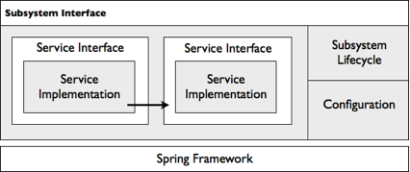
Subsystems
Subsystems are configurable modules responsible for a piece of functionality in Alfresco Content Services.
A subsystem can be thought of as a mini-server that runs embedded within the main Alfresco Content Services server.
A subsystem has the following characteristics:
It can be started, stopped, and configured independently of the Alfresco Content Services server during runtime
It has its own isolated Spring application context and configuration

Slide 15
Subsystems (contd.)
Few examples of subsystems include:
Audit: Configuration of audit parameters
Authentication: Contains different authentication subsystems such as LDAP
E-mail: SMTP support for sending e-mails
File servers: CIFS, FTP
Google Docs: Google Docs integration
IMAP: Internal IMAP server
Open Office transformations: Helps converting office documents to text
Search: Search system integration, Lucene, Solr, None
Synchronization: LDAP synchronization settings
Sys admin: It allows real-time control across some general repository parameters
Third-party: Owns the SWFTools and ImageMagick content transformers
Alfresco provides ability to create custom subsystems and configure them on Alfresco content server.

Slide 16
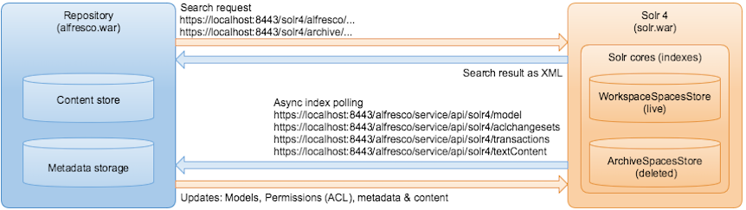
Solr Overview
Solr is an open source enterprise search platform that uses lucene as indexing and search engine.
Solr is written in Java and runs as a standalone search server.
Alfresco Content Services sends HTTP and XML input to Solr and searches for content.
Solr updates the cores or indexes and returns the result of the query in XML or JSON format.

Slide 17
Users, Groups, Roles and Permissions (Share)
Alfresco users and groups are created by the Alfresco administrator using the Alfresco Share Admin Tools.
A user's role determines what they can and cannot do in a site.
Each role has a default set of permissions.
Below are few roles and their permissions:
Managers have full rights to all site content
Collaborators have full rights to the site content that they own; they have rights to edit but not delete content created by other site members.
Contributors have full rights to the site content that they own; they cannot edit or delete content created by other site members.
Consumers have view-only rights in a site: they cannot create their own content.
Power Users
Alfresco Share power users have additional options that aren't available to standard users.
The current additional options available are:
Sites Manager
Search Manager
Notes:
http://docs.alfresco.com/5.2/references/permissions_share.html

Slide 18
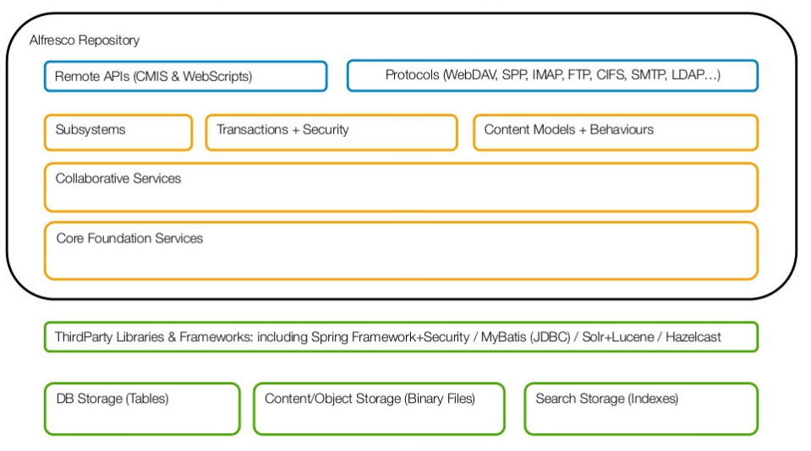
Repository Architecture

Slide 19
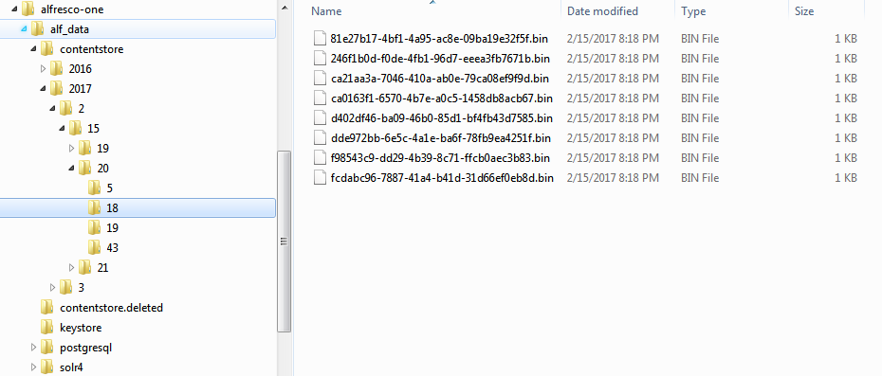
Repository – Physical Structure
All files that are stored in Alfresco Content Services are stored in what is referred to as the repository.
The repository is a logical entity that consists of three important parts:
physical content files that are uploaded
index files created when indexing the uploaded file so it is searchable
metadata/properties for the file, which are stored in a relational database management system (RDBMS).
Notes:
When a file is uploaded to the repository it is stored on disk in a special directory structure that is based on the date and time of the upload. The file name is also changed to the UUID (Universally Unique Identifier) assigned to the file when it is added to the repository. The file's metadata is stored in an RDBMS such as PostgreSQL. Indexes are also stored on the disk. When the file is added to the repository it is stored in a folder, and the folder has domain specific metadata, rules, and fine grained permissions. The top folder in the repository is called Company Home, although it will be referred to with the name repository in the Alfresco Share user interface.

Slide 20
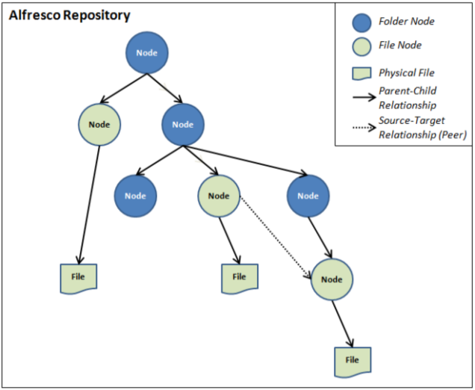
Repository – Logical Structure
All the files and folders that are uploaded and created in the repository are referred to as nodes.
Nodes can also be associated with other nodes in a peer to peer relationship.
All nodes live in a Store.
Each store has a root node at the top, and nodes can reference specific files, as shown in the following diagram:
Notes:
When a file is uploaded to the repository it is stored on disk in a special directory structure that is based on the date and time of the upload. The file name is also changed to the UUID (Universally Unique Identifier) assigned to the file when it is added to the repository. The file's metadata is stored in an RDBMS such as PostgreSQL. Indexes are also stored on the disk. When the file is added to the repository it is stored in a folder, and the folder has domain specific metadata, rules, and fine grained permissions. The top folder in the repository is called Company Home, although it will be referred to with the name repository in the Alfresco Share user interface.

Slide 21
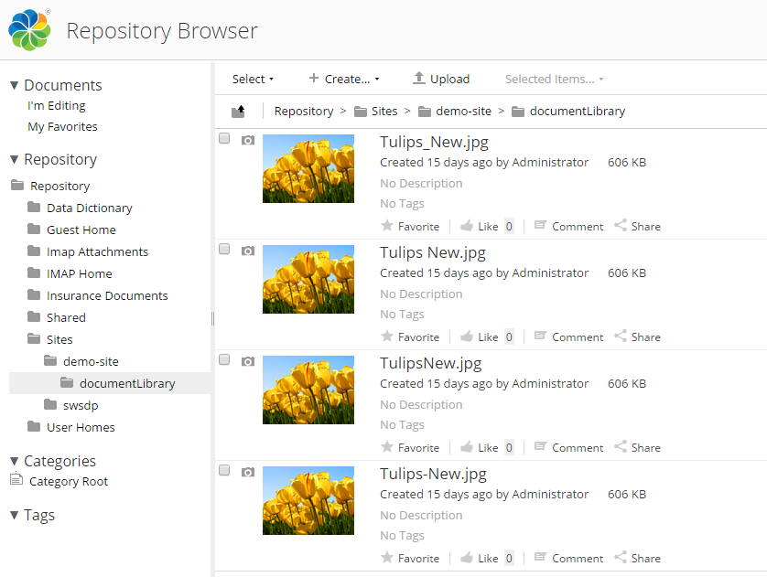
Repository – Logical Structure
Notes:
When a file is uploaded to the repository it is stored on disk in a special directory structure that is based on the date and time of the upload. The file name is also changed to the UUID (Universally Unique Identifier) assigned to the file when it is added to the repository. The file's metadata is stored in an RDBMS such as PostgreSQL. Indexes are also stored on the disk. When the file is added to the repository it is stored in a folder, and the folder has domain specific metadata, rules, and fine grained permissions. The top folder in the repository is called Company Home, although it will be referred to with the name repository in the Alfresco Share user interface.

Slide 22
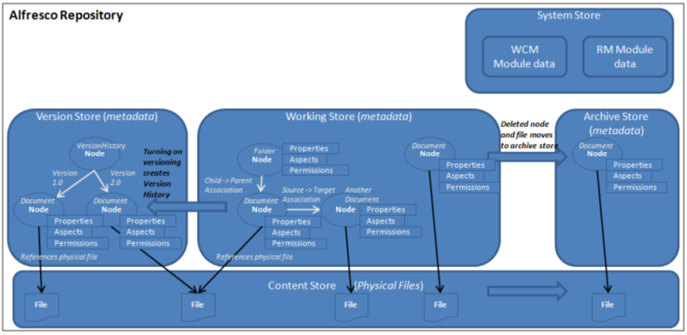
Repository – Logical Structure – Content stores
Each node resides in only one store.
Repository contains multiple logical stores.
Notes:
When a file is uploaded to the repository it is stored on disk in a special directory structure that is based on the date and time of the upload. The file name is also changed to the UUID (Universally Unique Identifier) assigned to the file when it is added to the repository. The file's metadata is stored in an RDBMS such as PostgreSQL. Indexes are also stored on the disk. When the file is added to the repository it is stored in a folder, and the folder has domain specific metadata, rules, and fine grained permissions. The top folder in the repository is called Company Home, although it will be referred to with the name repository in the Alfresco Share user interface.

Slide 23


Slide 24
Thank you

